Slide 1
VVV 2016 Reunion Host, Chad Bugos
Bentonville, Arkansas

Slide 2
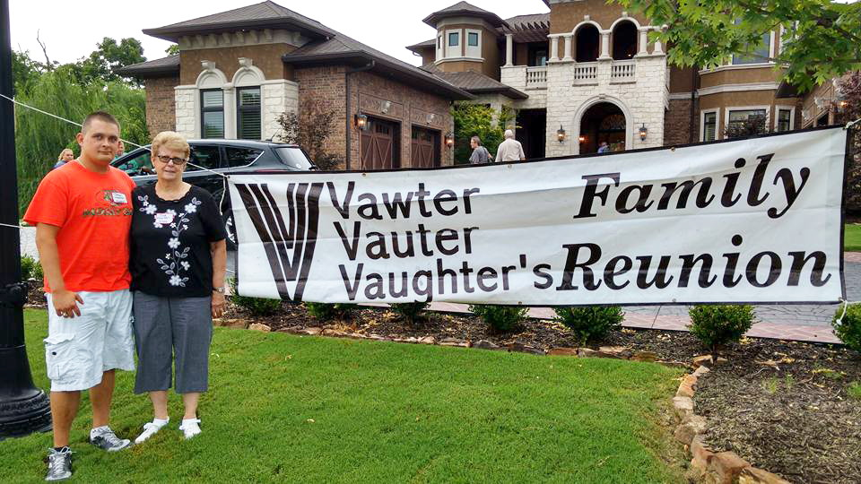
The 40th Reunion
Jason Vawter and Sue Vawter

Slide 3
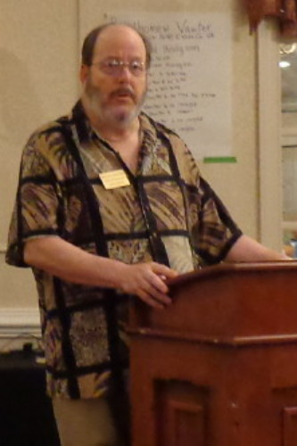
Bruce Vawter, VVV President, Passed away Wednesday, July 6, 2016.
Beloved husband of Linda Vawter. Dear father of Kenneth Vawter, Lori (Scott) Shepherd and Jason Vawter;
dear grandfather of 5 and great-grandfather of 3; dear brother of Shirley (Jerry) Beasley, Wayne (Carole) Vawter,
Roger (Margie) Vawter and Gary (Penny) Vawter; and dear uncle, great-uncle, cousin and friend to many.

Slide 4
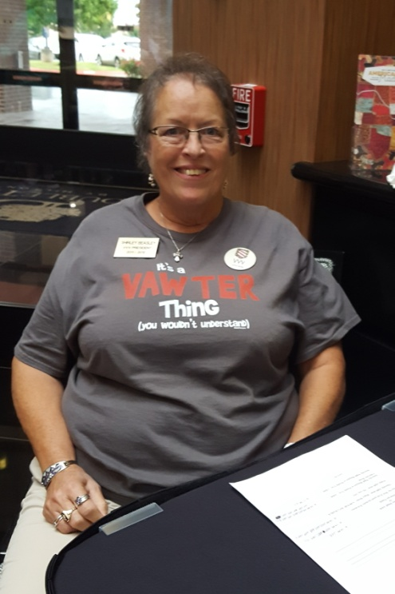
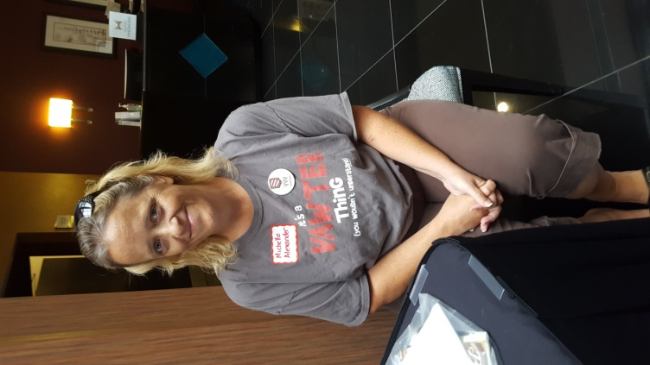
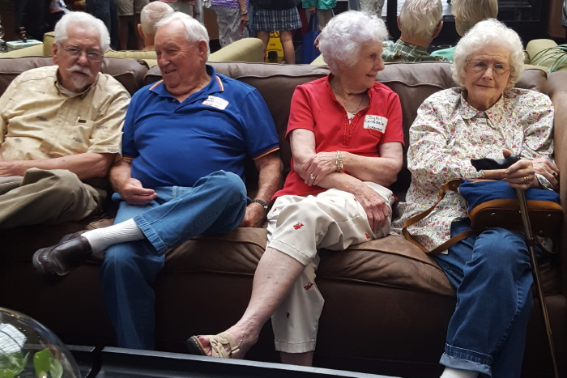
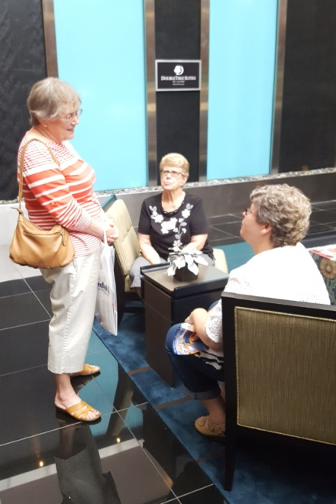
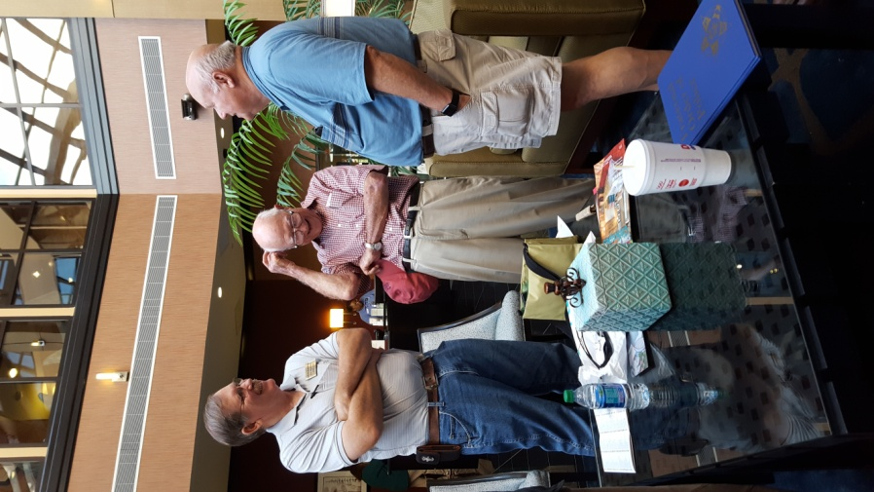
The DoubleTree hotel
Shirley and Michelle handled registration and showed off their Vawter thang shirts.
Just visiting….Ken, Harold, Sybil and Norma
Wilma, Sue and Renae
Jordan, Fred and Bob

Slide 5
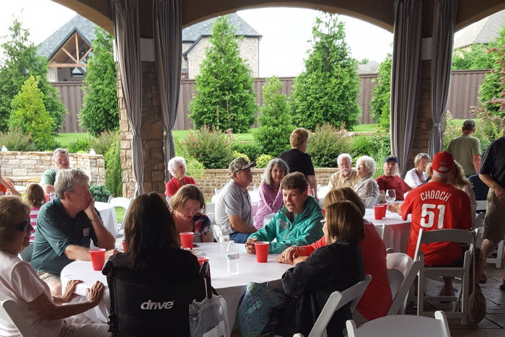
Welcome dinner on the first night

Slide 6
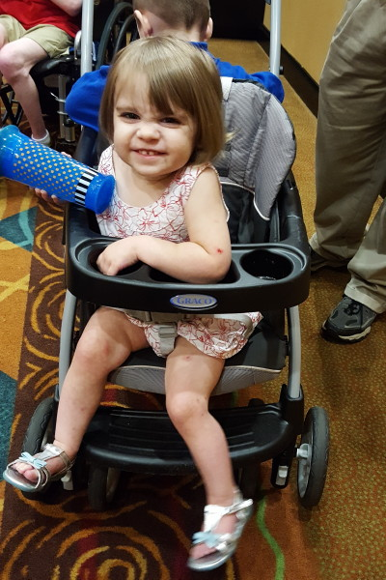
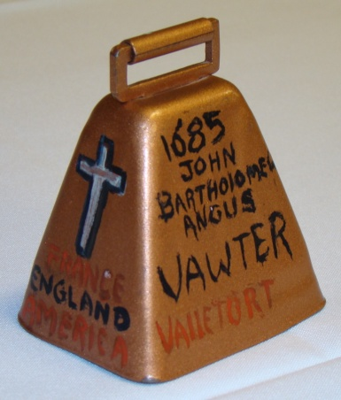
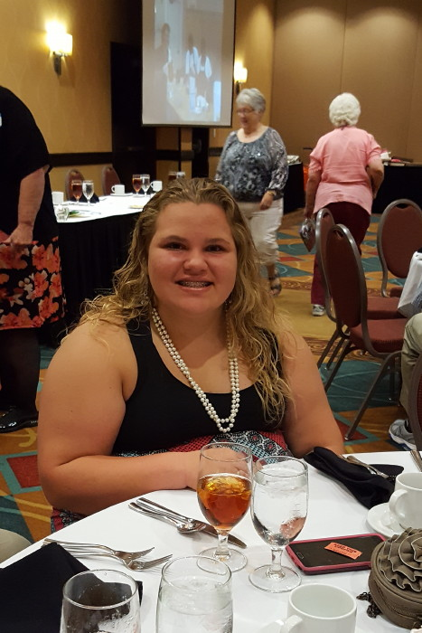
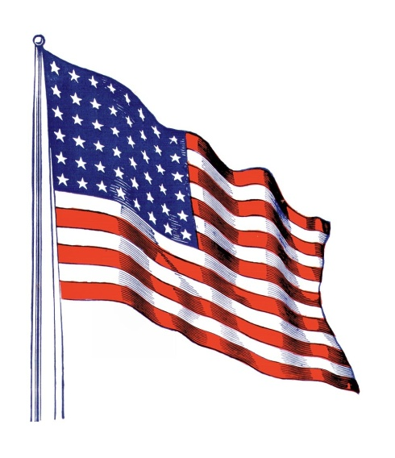
Corinne Smith rang the traditional cowbell to open the meeting.
Reba Alexander led the Pledge of Allegiance

Slide 7
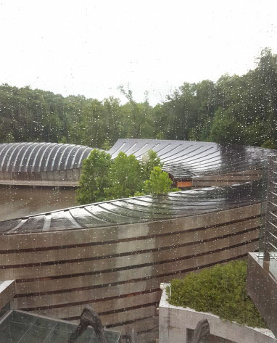
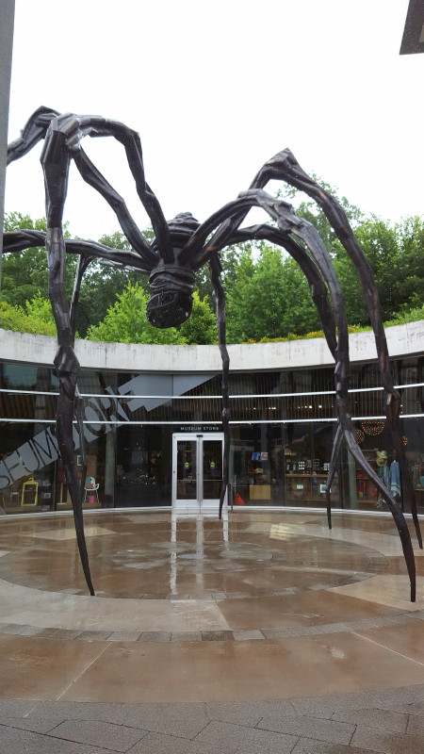

Slide 8
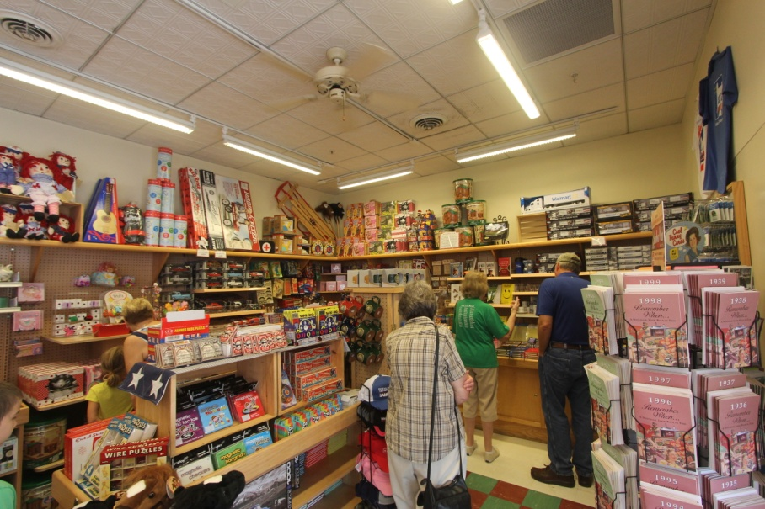
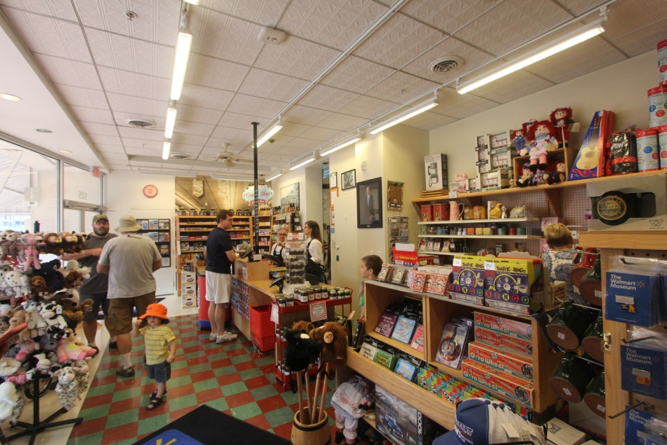
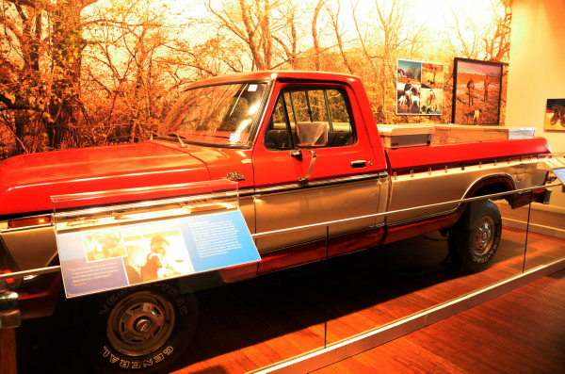
Downtown Bentonville on the square
Sam Walton’s truck

Slide 9
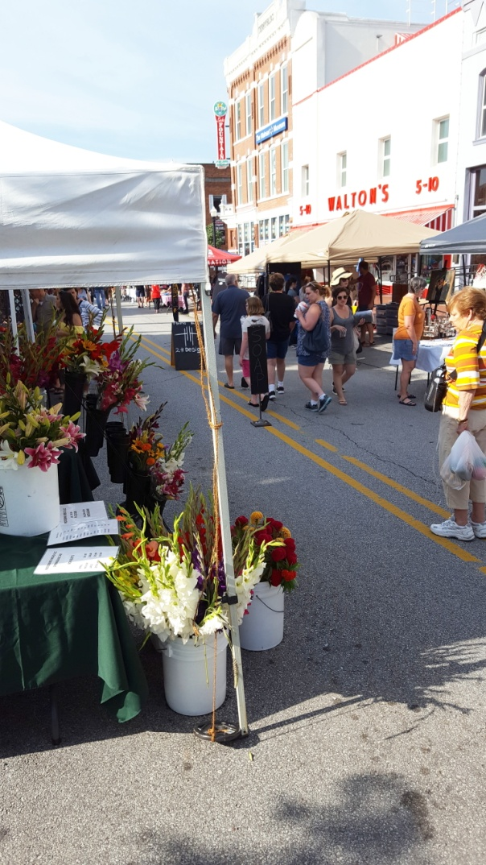
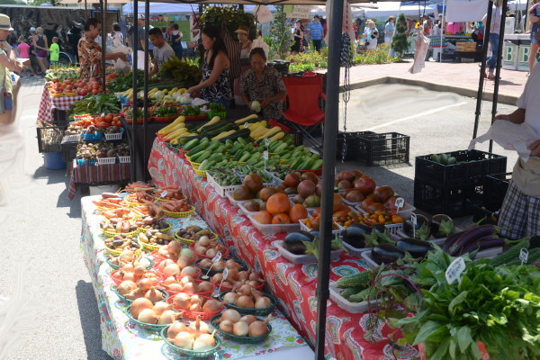
Farmer’s market on the square

Slide 10
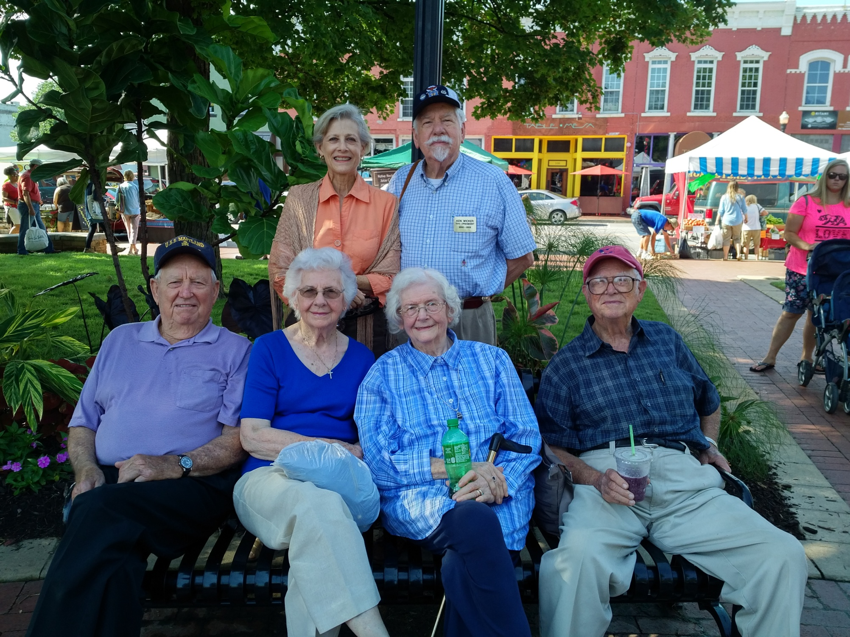
Relaxing on the square: Ellen, Ken, Harold, Sybil, Norma and Fred

Slide 11
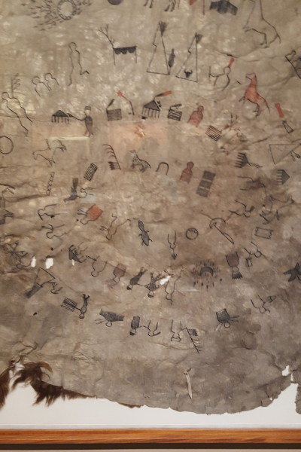
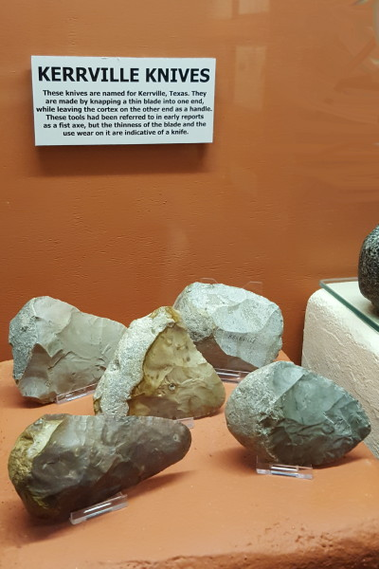
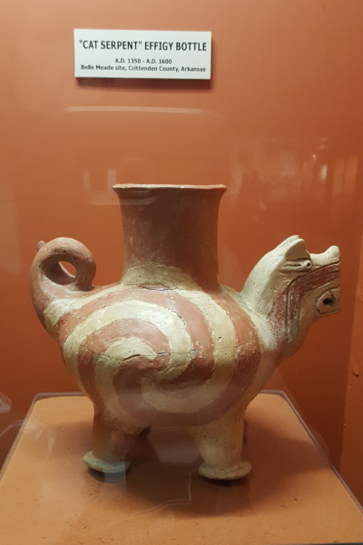
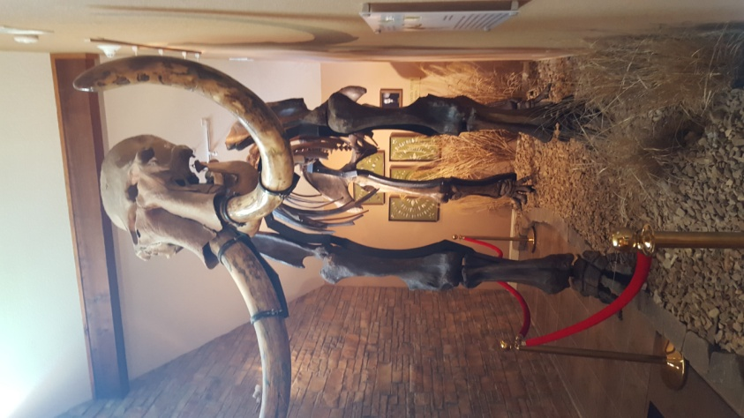
Buffalo hide used as a calendar.

Slide 12
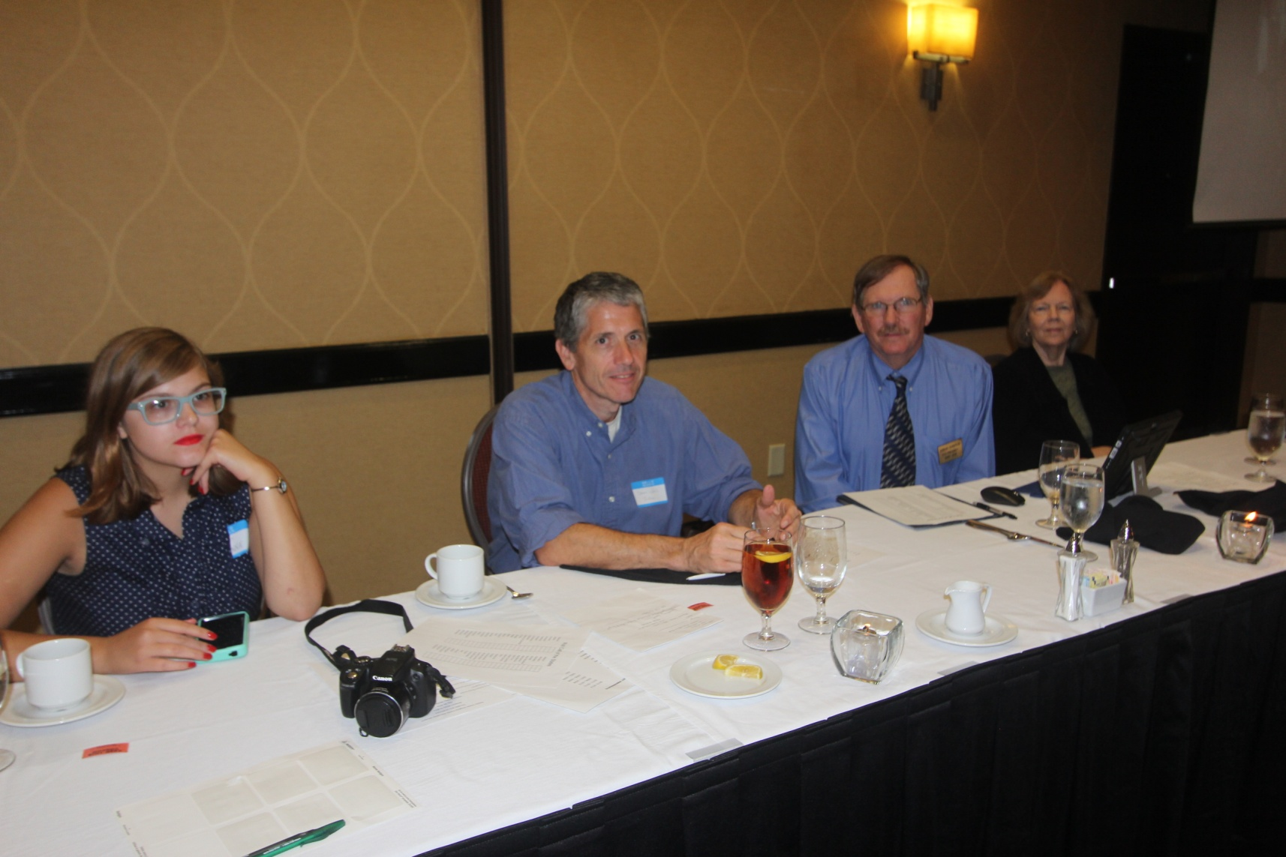
The Banquet

Slide 13
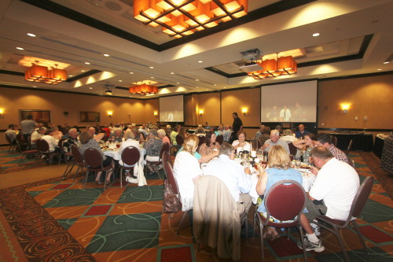

Slide 14
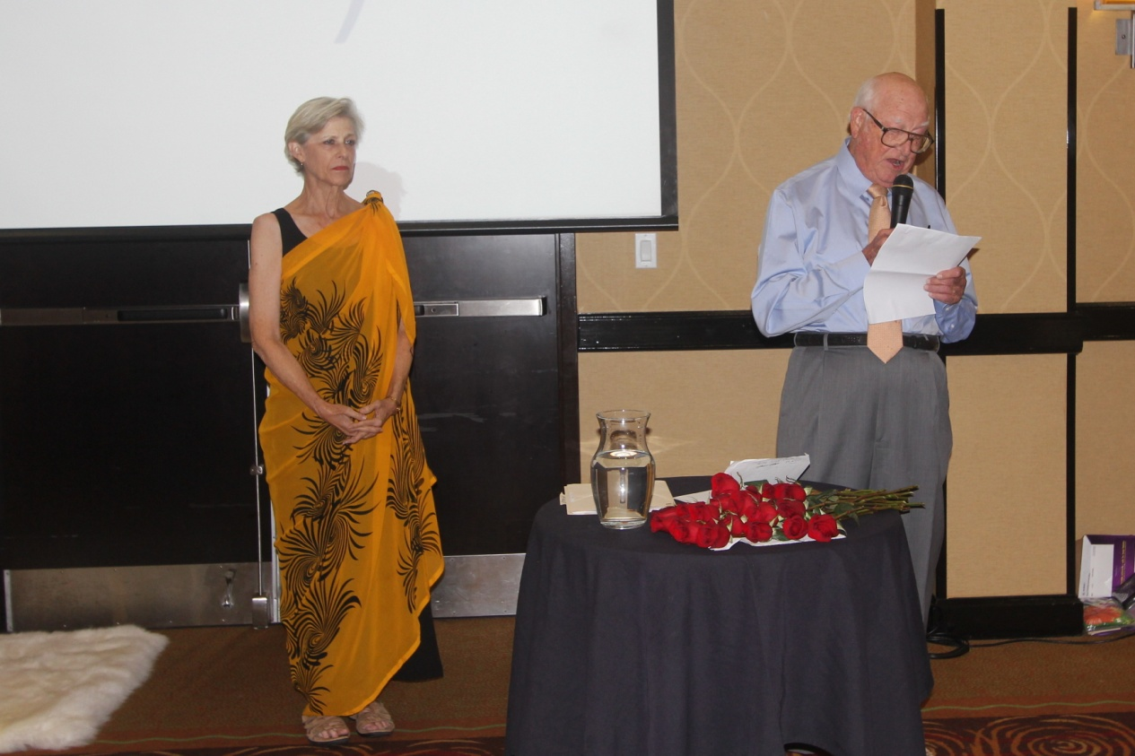
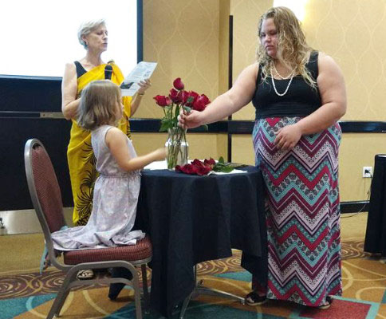
The Memorial service

Slide 15
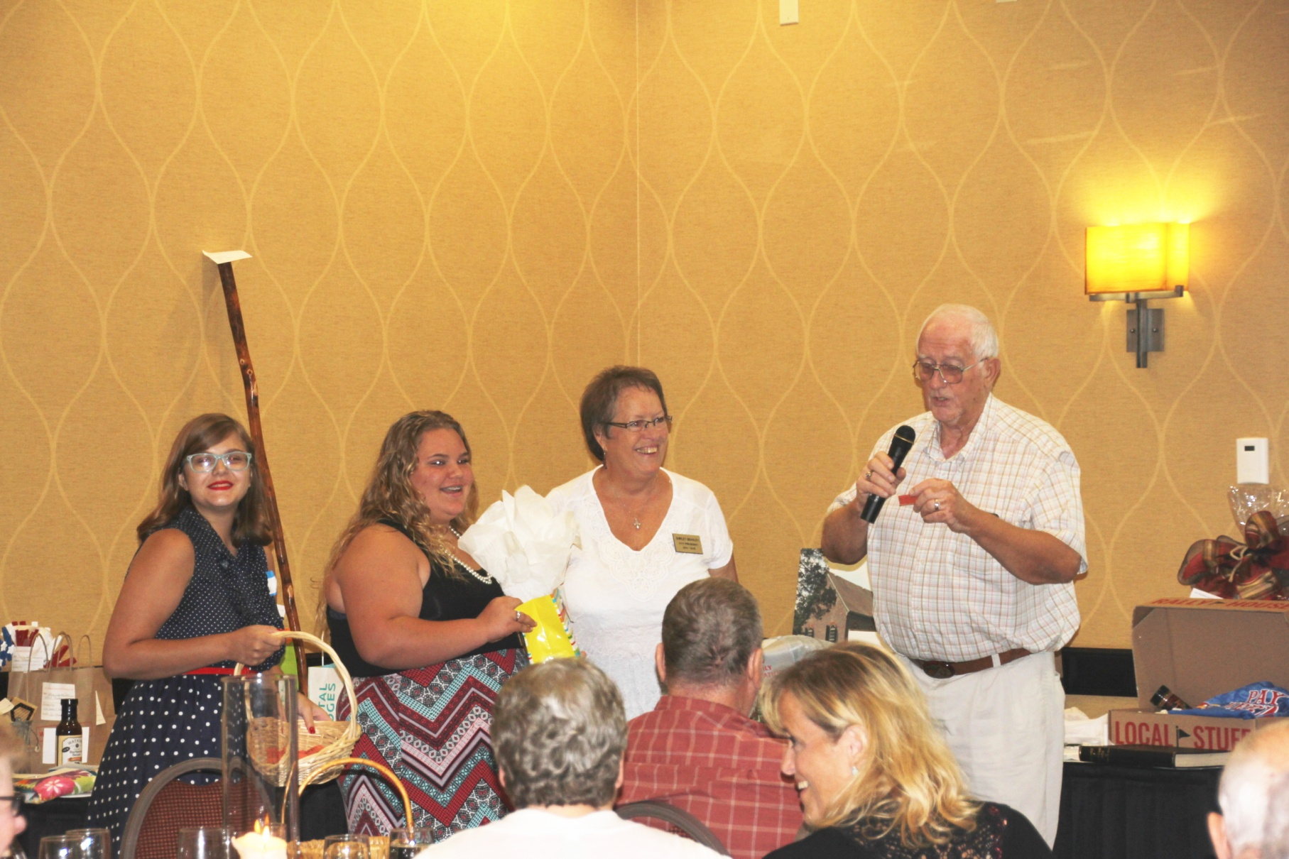
Anna Welch and Reba Alexander help Shirley and Jerry Beasley
Give out the door prizes.

Slide 16
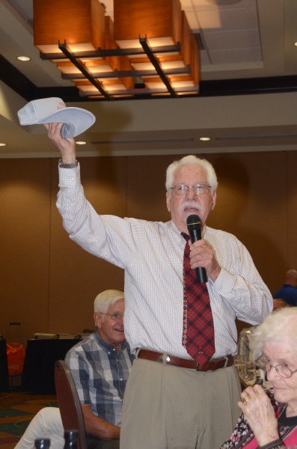
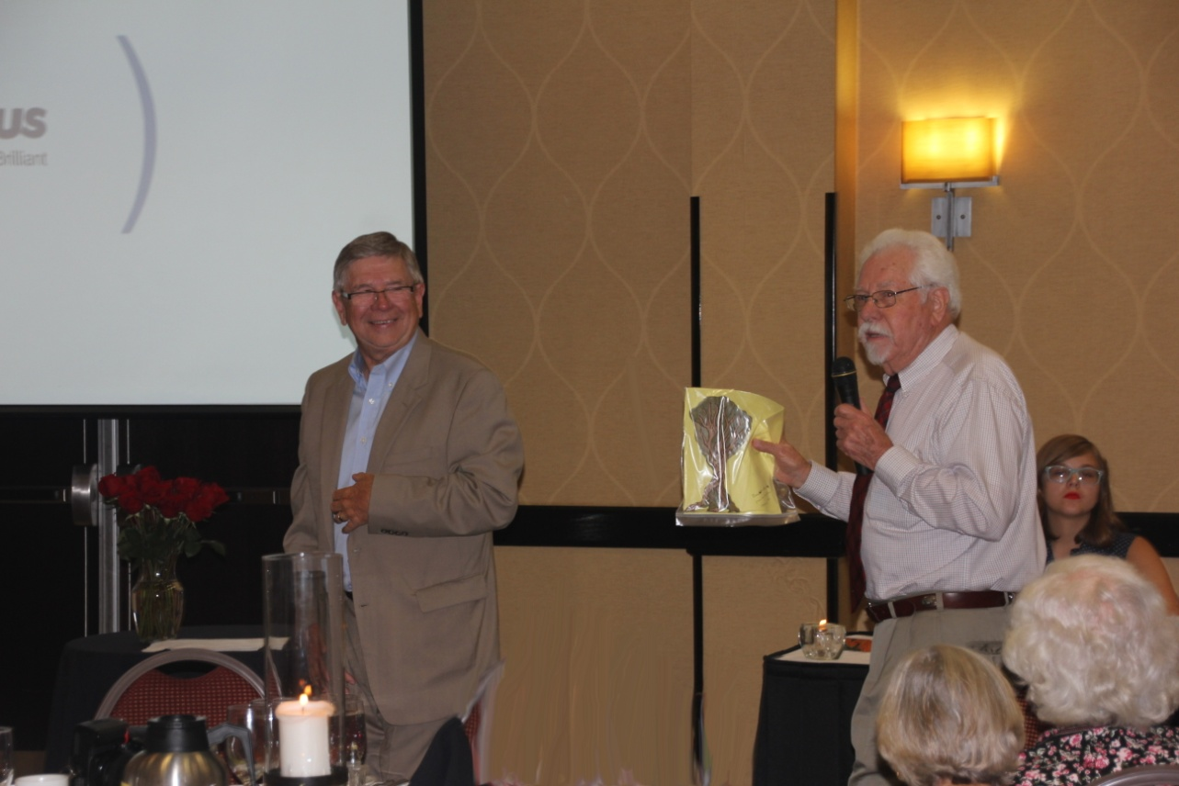
And the auction
Lowell Vaughters helped Ken Wicker

Slide 17
A big “Thank You” to Bob Vawter
and Michael McNary for the photographs.

